Slide 1
Distributed Mutual Exclusion
Distributed Mutual Exclusion:- Classification -Requirements – Measuring Performance – Lamport’s Algorithm – Rickart-Agarwala Algorithm – Suzuki- Kasami’s Broadcast Algorithm.

Slide 2
Mutual Exclusion in Single-computer system Vs Distributed System
Solutions to Mutual exclusion problem can be easily implemented using shared variables in single computer system.
Because of the shared memory, the status of shared resources and users is readily available.
But in distributed systems shared resources and users are distributed and shared memory doesn’t exist.
So approaches based on shared variables are not applicable and approaches based on message passing must be used.

Slide 3
Classification of Mutual Exclusion Algorithms
Mutual exclusion algorithms in distributed system are classified mainly into two classes:
Token based
Non-token based
In the non-token-based approach, two or more successive rounds of messages are exchanged among the Process to determine who will enter the CS next.
A Process enters the critical section (CS) when an assertion, defined on its local variables, becomes true.

Slide 4
Classification of Mutual Exclusion Algorithms
In the token-based approach, a unique token is shared among the process.
A process is allowed to enter its CS if it possesses the token and it continues to hold the token until the execution of the CS is over.
Mutual exclusion is ensured because the token is unique.

Slide 5
Requirements of ME Algorithms
The primary objective of ME algorithm is to guarantee that only one request access the Cs at a time.
In addition following characteristics are also considered important:
Freedom from dead locks: Two or more sites/process should not endlessly wait for messages that will never arrive.
Freedom from starvation:A site must not wait indefinitely to execute
the CS while other sites are repeatedly executing the CS.

Slide 6
Requirements of ME Algorithms
3. Fairness: Fairness property generally means that the CS execution requests are executed in order of their arrival in the system.
4. Fault Tolerance: In case of a failure, the algorithm can reorganize itself so that it continues to function without any disruptions

Slide 7
Measuring Performance
The performance of mutual exclusion algorithms are generally measured by the following 4 metrics:
Message Complexity
Synchronization delay
Response time
System throughput

Slide 8
Measuring Performance
Message Complexity: This is the number of messages that are required
per CS execution by a site.
Synchronization delay: After a site leaves the CS, it is the time required and before the next site enters the CS
Response time: This is the time interval a request waits for its CS execution to be over after its request messages have been sent out
System throughput: It is the rate at which the system executes requests for the CS.

Slide 9
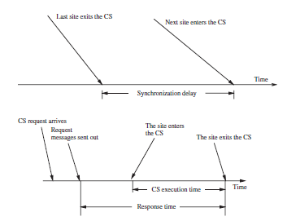
Measuring Performance
If SD is the synchronization delay and E is the average critical section execution time, then the throughput is given by the following equation:
System throughput = 1/(SD+E)

Slide 10
Low and high load performance
Performance of a mutual exclusion algorithm depends upon the load.
Performance of mutual exclusion algorithms are studied under two special loading conditions, “low load” and “high load.”
Under low load conditions, there is seldom more than one request for the critical section present in the system simultaneously.

Slide 11
Low and high load performance
Under heavy load conditions, there is always a pending request for critical section at a site.
A site is seldom in the idle state in heavy load conditions.
Performance metrics for ME algorithms can be easily calculated with mathematical reasoning.

Slide 12
Best and worst case performance
In the best case, prevailing conditions are such that a performance metric attains the best possible value.
In most mutual exclusion algorithms the best value of the response time is a roundtrip message delay plus the CS execution time, 2T +E.
The best and worst cases coincide with low and high loads, respectively.

Slide 13
Best and worst case performance
In the best case, prevailing conditions are such that a performance metric attains the best possible value.
In most mutual exclusion algorithms the best value of the response time is a roundtrip message delay plus the CS execution time, 2T +E.
The best and worst cases coincide with low and high loads, respectively.

Slide 14
NON TOKEN BASED ALGORITHMS
In non token based algorithms a site communicate with a set of other sites to decide who should execute the CS next.
For a site Si Request set Ri contains ids of all those sites from which site Si must acquire permission before entering the CS
Non token based algorithms uses time-stamps to order requests for CS and to resolve conflicts between simultaneous requests for the CS
These algorithms maintain logical clocks and update them according to Lamport’s Scheme.
Each request for CS gets a timestamp and smaller time stamp requests gets priority over larger time stamp requests

Slide 15
Lamport’s algorithm
Lamport developed a distributed mutual exclusion algorithm as an illustration of his clock synchronization scheme.
A request for CS are executed in the order of their timestamps and time is determined by logical clocks.
When a site processes a request for the CS, it updates its local clock and assigns the request a timestamp.
The algorithm executes CS requests in the increasing order of timestamps.
Every site Si keeps a queue, request_queuei, which contains mutual exclusion requests ordered by their timestamps.

Slide 16
Lamport’s algorithm: Requesting Critical Section
When a site Si wants to enter the CS, it broadcasts a REQUEST(tsi, i) message to all other sites and places the request on request_queuei.
When a site Sj receives the REQUEST(tsi, i) message from site Si, it places site Si’s request on request_queuej and returns a timestamped REPLY message to Si.

Slide 17
Lamport’s algorithm: Executing the critical section
Site Si enters the CS when the following two conditions hold:
L1: Si has received a message with timestamp larger than (tsi, i) from all other sites.
L2: Si’s request is at the top of request_queuei

Slide 18
Lamport’s algorithm: Releasing the critical section
Site Si, upon exiting the CS, removes its request from the top of its request queue and broadcasts a timestamped RELEASE message to all other sites.
When a site Sj receives a RELEASE message from site Si, it removes Si’s request from its request queue.
When a site removes a request from its request queue, its own request may come at the top of the queue, enabling it to enter the CS.

Slide 19
Lamport’s algorithm: Releasing the critical section
Site Si, upon exiting the CS, removes its request from the top of its request queue and broadcasts a timestamped RELEASE message to all other sites.
When a site Sj receives a RELEASE message from site Si, it removes Si’s request from its request queue.
When a site removes a request from its request queue, its own request may come at the top of the queue, enabling it to enter the CS.

Slide 20
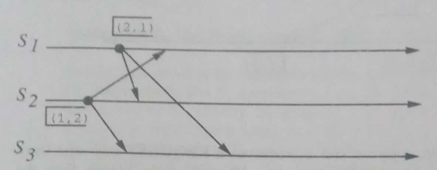
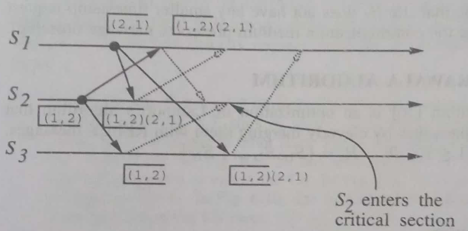
Lamport’s algorithm: Example
S1 and S2 making request for CS
S2 entering the CS
S2 entering the CS

Slide 21
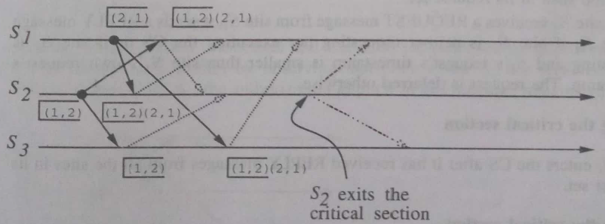
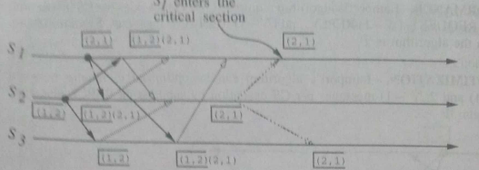
Lamport’s algorithm: Example
S2 exits from CS and sends release message
S1 entering the CS

Slide 22
Lamport’s algorithm: Performance
For each CS execution, Lamport’s algorithm requires N −1 REQUEST messages, N −1 REPLY messages, and N −1 RELEASE messages.
Ie, it requires 3(N-1) messages per CS invocation.
The Lamport’s Algorithm can be optimized by reducing the no:of message to lie between 3(N-1) and 2(N-1).
This can be achieved by supressing REPLY messages in certain situations

Slide 23
Ricart–Agrawala algorithm
The Ricart–Agrawala algorithm assumes that the communication channels are FIFO.
The algorithm uses two types of messages:
REQUEST
REPLY.
A process sends a REQUEST message to all other processes to request their permission to enter the critical section.
A process sends a REPLY message to a process to give its permission to that process.

Slide 24
Ricart–Agrawala algorithm
Lamport-style logical clocks to assign a timestamp to critical section requests.
Timestamps are used to decide the priority of requests in case of conflict.
In this algorithm ,for every requesting site, the site with higher priority(smaller timestamp) will always defer the request of the lower priority site.
So the process with high priority gets to execute the CS

Slide 25
Ricart–Agrawala algorithm- Requesting critical section
When a site Si wants to enter the CS, it broadcasts a timestamped REQUEST message to all other sites.
When site Sj receives a REQUEST message from site Si, it sends a REPLY message to site Si :
1) If site Sj is neither requesting nor executing the CS, or
2) If the site Sj is requesting and Si’s request’s timestamp is smaller than site Sj’s own request timestamp.
Otherwise the Request is deferred

Slide 26
Ricart–Agrawala algorithm- Executing and Releasing critical section
Executing the critical section
Site Si enters the CS after it has received a REPLY message from every site it sent a REQUEST message to.
Releasing the critical section
When site Si exits the CS, it sends all the REPLY messages to all deferred requests.
The site with next highest priority request receives the last needed REPLY message and enters the CS

Slide 27
Ricart–Agrawala algorithm- Performance
For each CS execution, the Ricart–Agrawala algorithm requires N − 1 REQUEST messages and N − 1 REPLY messages.
Thus, it requires 2(N −1) messages per CS execution.

Slide 28
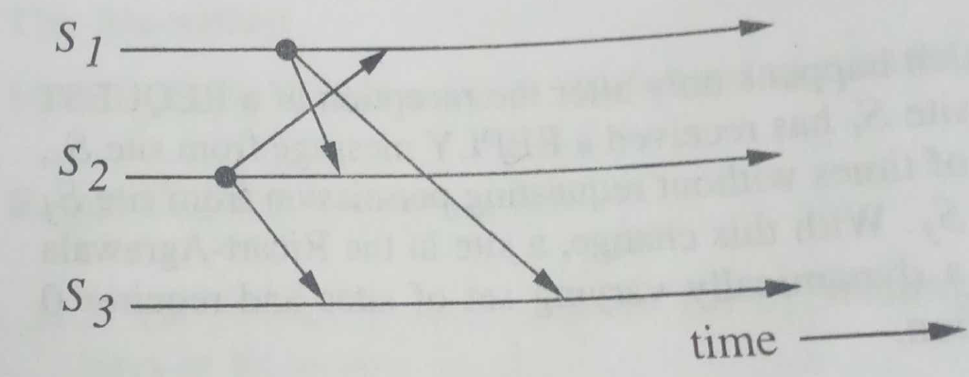
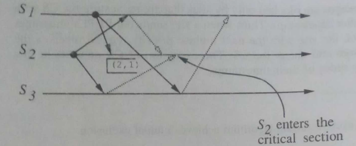

Slide 29
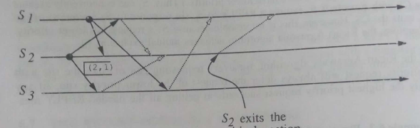
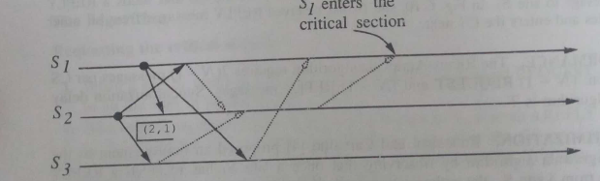

Slide 30
TOKEN-BASED algorithm
A unique token is shared among all sites
A site is allowed to enter its critical session if it possesses the token
Token based algorithms uses sequence numbers instead of time stamps
Every request for token contains a sequence number and sequence numbers of sites advance independently.
A site increments its sequence number counter every time it makes a request for token
Primary function of sequence number is to distinguish b/w old and current request for token

Slide 31
SUZUKI –KASami’s Broadcast algorithm
If a site attempting to enter a CS does not have the token, it broadcasts a REQUEST message for the token to all other sites.
A site that possesses the token sends it to the site that sends the REQUEST message.
If the site possessing the token is executing the CS, it sends the token only after it has exited the CS.
A site holding the token can repeatedly enter the critical session until it sends the token to some other site.

Slide 32
SUZUKI –KASami’s Broadcast algorithm
The main design issues in this algorithm are:
How to distinguishing an outdated REQUEST message from a current REQUEST message.
How to determine which site has an outstanding request for the CS
Notes:
Due to variable message delays, a site may receive a token request message after the corresponding request has been satisfied.
If a site cannot determined if the request corresponding to a token request has been satisfied, it may dispatch the token to a site that does not need it.
After a site has finished the execution of the CS, it must determine what sites have an outstanding request for the CS so that the token can be dispatched to one of them.

Slide 33
SUZUKI –KASami’s Broadcast algorithm
Outdated REQUEST messages are distinguished from current REQUEST messages in the following manner:
A REQUEST message of site Sj has the form REQUEST(j, n) where n (n = 1 2 ) is a sequence number that indicates that site Sj is requesting its nth CS execution.
A site Si keeps an array of integers RNi[1, … ,N] where RNi[j] denotes the largest sequence number received in a REQUEST message so far from site Sj.
When site Si receives a REQUEST(j, n) message, it sets RNi[j]= max(RNi[j], n).

Slide 34
SUZUKI –KASami’s Broadcast algorithm
When a site Si receives a REQUEST(j, n) message, the request is outdated if RNi[j]> n.
Sites with outstanding requests for the CS are determined in the following manner:
the token consists of a queue of requesting sites, Q, and an array of integers LN[1, … ,N], where LN[j] is the sequence number of the request which site Sj executed most recently.
After executing its CS, a site Si updates LN[i] : = RNi[i] to indicate that its request corresponding to sequence number RNi[i] has been executed.
Token array LN[1, … ,N] permits a site to determine if a site has an outstanding request for the CS.

Slide 35
SUZUKI –KASami’s Broadcast algorithm
In Site Si if RNi[j]=LN[j]+1, then site Sj is currently requesting a token.
After executing the CS, a site checks this condition for all the j’s to determine all the sites that are requesting the token and places their i.d.’s in queue Q if these i.d.’s are not already present in Q.
Finally the site sends the token to the site whose i.d. is at the head of Q.

Slide 36
Requesting the critical section:
If requesting site Si does not have the token, then it increments its sequence number, RNi[i], and sends a REQUEST(i, sn) message to all other sites. (“sn” is the updated value of RNi[i])
When a site Sj receives this message, it sets RNj[i] to max(RNj[i], sn). If Sj has the idle token, then it sends the token to Si if RNj[i]=LN[i]+1.

Slide 37
Executing and releasing the critical section:
Executing CS
Site Si executes the CS after it has received the token.
Releasing the CS
Having finished the execution of the CS, site Si takes the following actions:
It sets LN[i] element of the token array equal to RNi[i].
For every site Sj whose i.d. is not in the token queue, it appends its i.d. to the token queue if RNi[j] = LN[j]+1.
If the token queue is nonempty after the above update, Si deletes the top site i.d. from the token queue and sends the token to the site indicated
by the i.d.

Slide 38
Executing and releasing the critical section:
Executing CS
Site Si executes the CS after it has received the token.
Releasing the CS
Having finished the execution of the CS, site Si takes the following actions:
It sets LN[i] element of the token array equal to RNi[i].
For every site Sj whose i.d. is not in the token queue, it appends its i.d. to the token queue if RNi[j] = LN[j]+1.
If the token queue is nonempty after the above update, Si deletes the top site i.d. from the token queue and sends the token to the site indicated
by the i.d.

